Slide 1
Syntax Analyser
Part-4

Slide 2
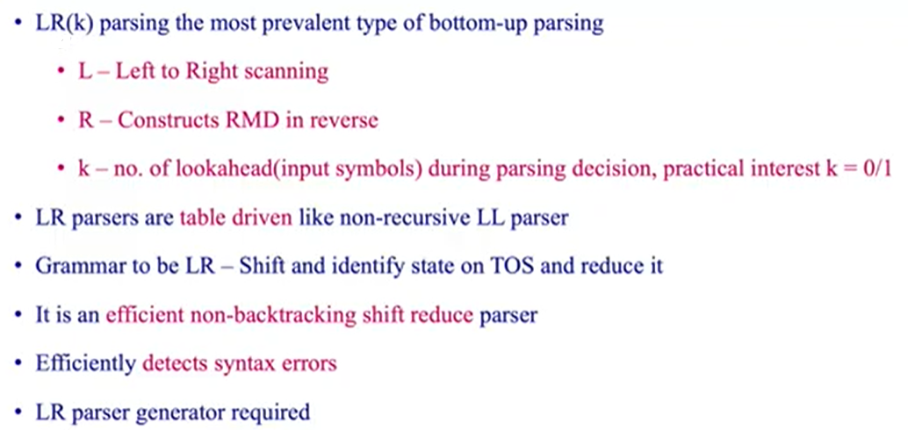
LR Parser

Slide 3
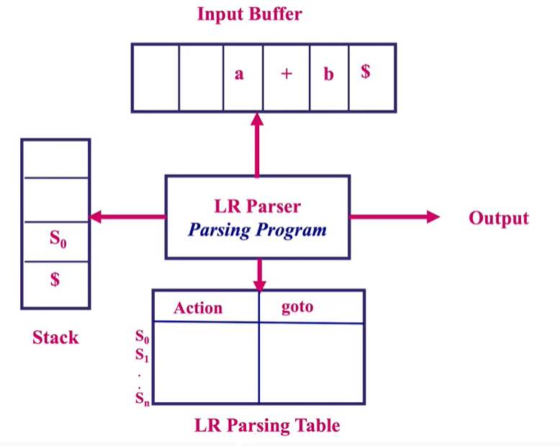
Structure of LR Parser

Slide 4
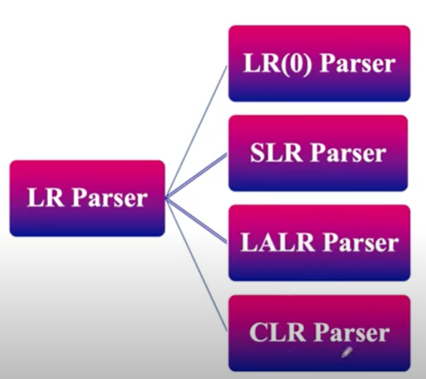
Types of LR Parser

Slide 5
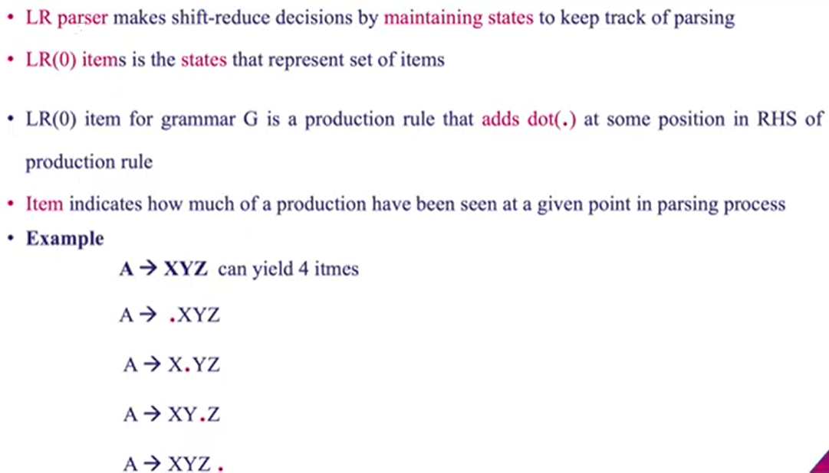
LR(0) Items

Slide 6
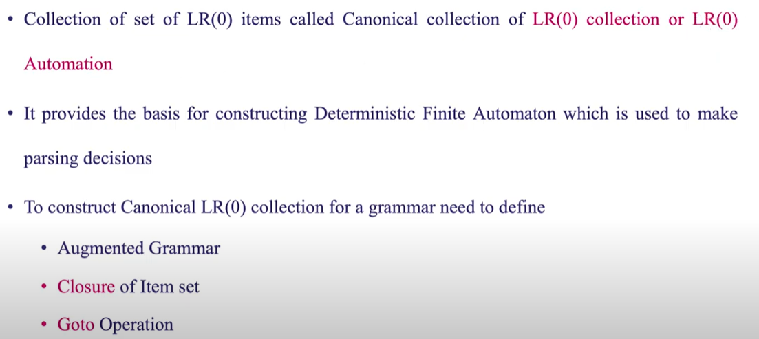
LR(0) Items (Contd.)

Slide 7
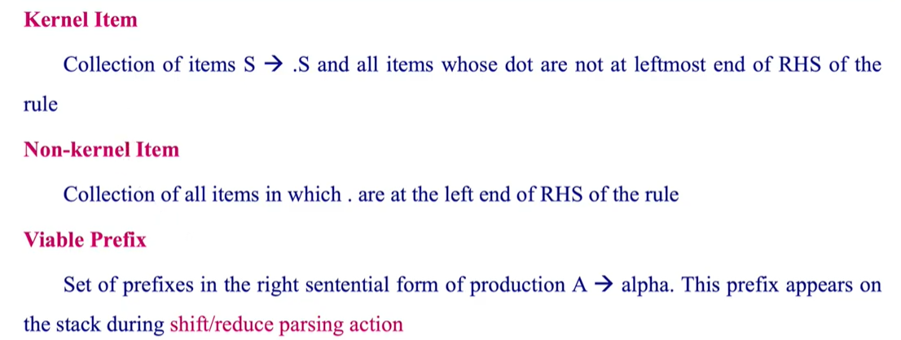
Kernel & Non-Kernel Items

Slide 8
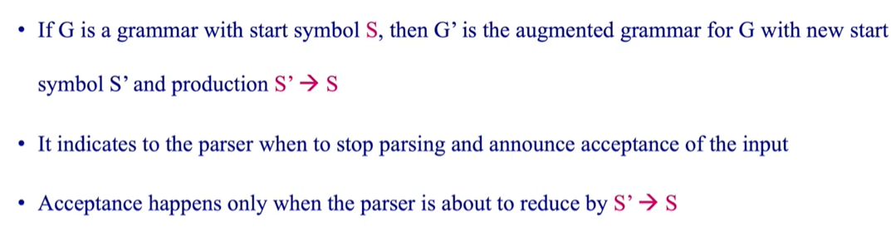
Augmented Grammar

Slide 9
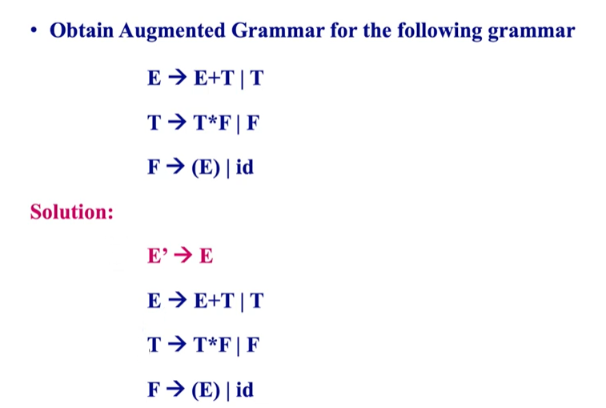
Augmented Grammar (Example)

Slide 10
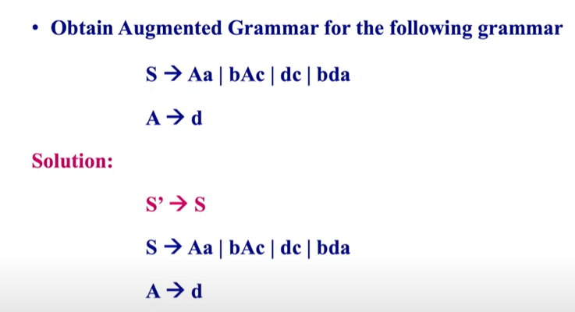
Augmented Grammar (Example)

Slide 11
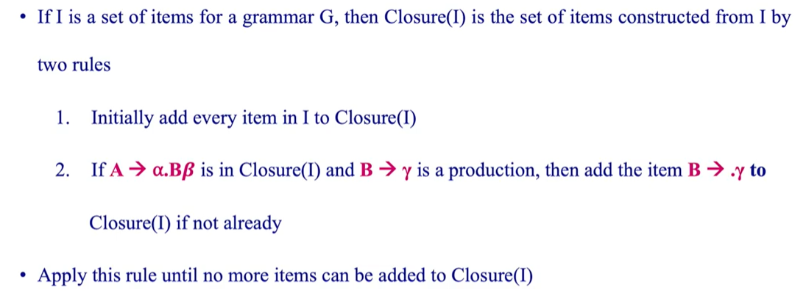
Closure of Item Sets

Slide 12
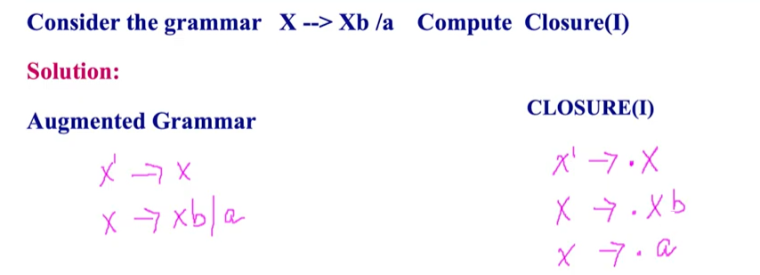
Closure of Item Sets (Example)

Slide 13
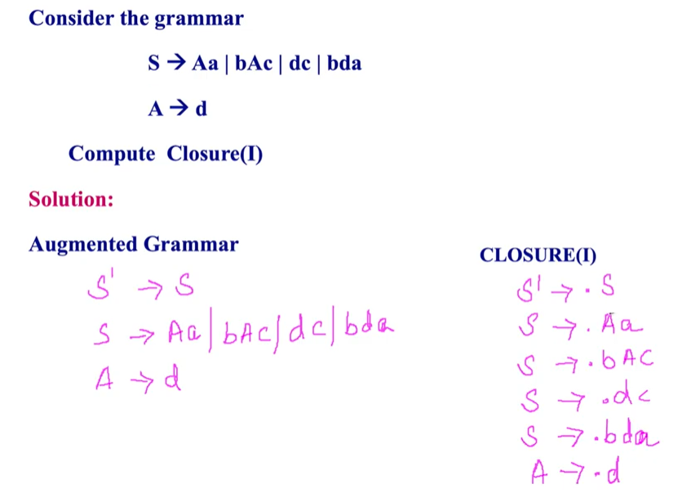
Closure of Item Sets (Example)

Slide 14
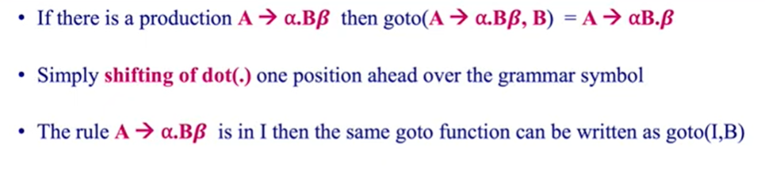
GOTO Operation

Slide 15
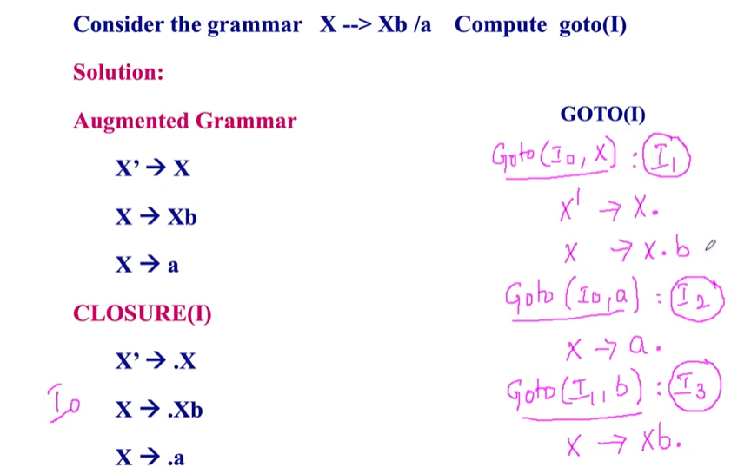
GOTO Operation (Example)

Slide 16
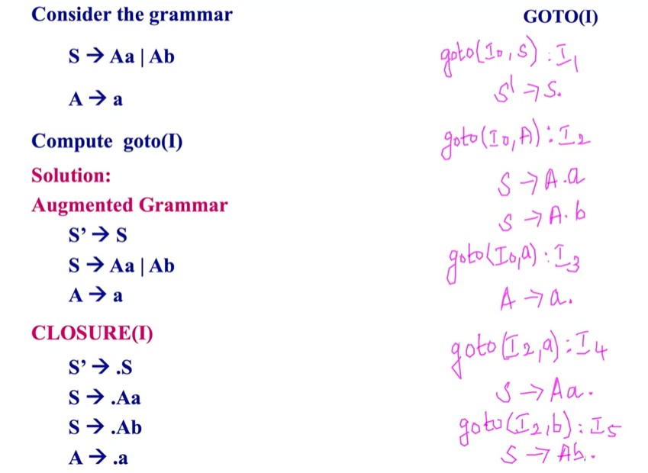
GOTO Operation (Example)

Slide 17
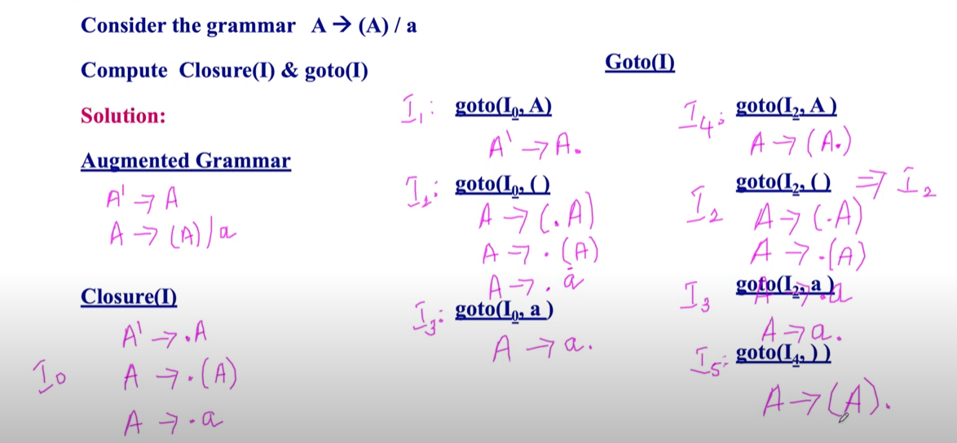
Compute Closure and Goto

Slide 18
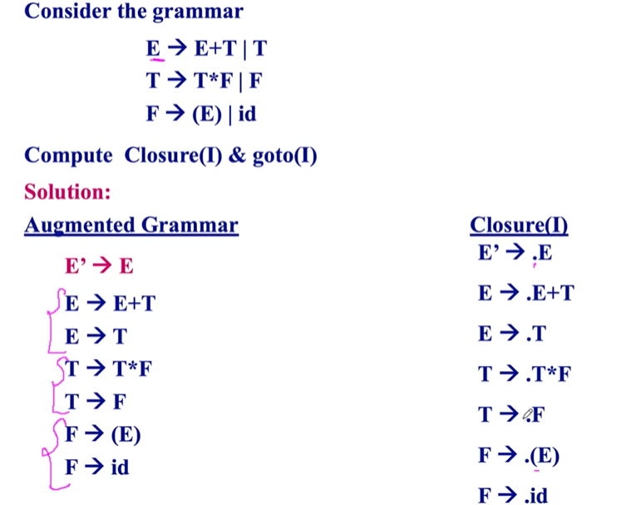

Slide 19
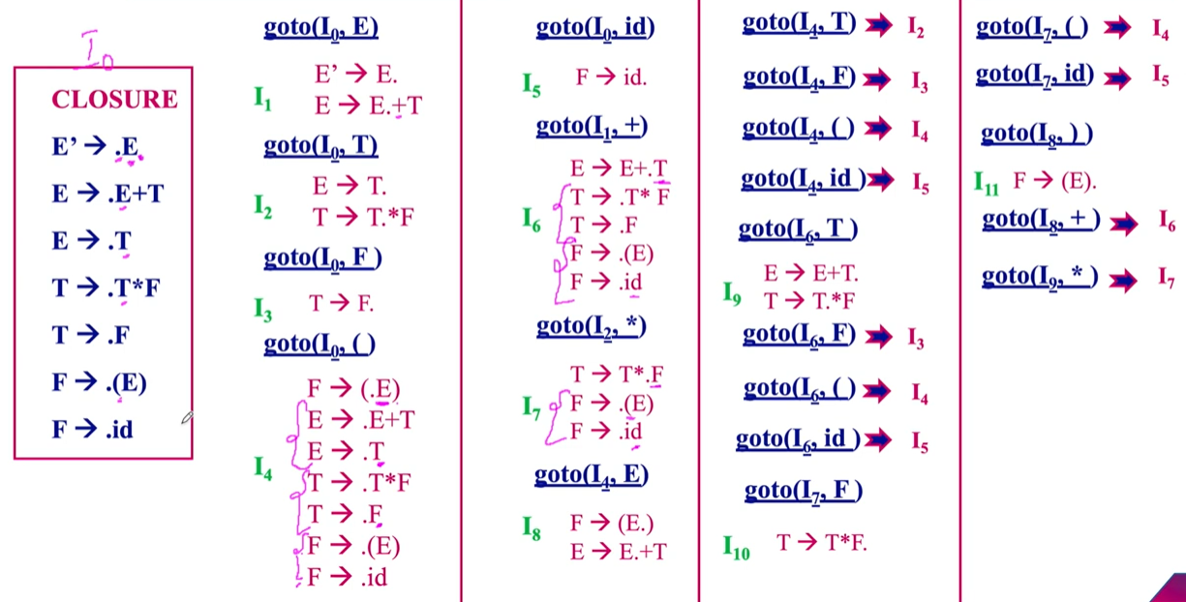

Slide 20
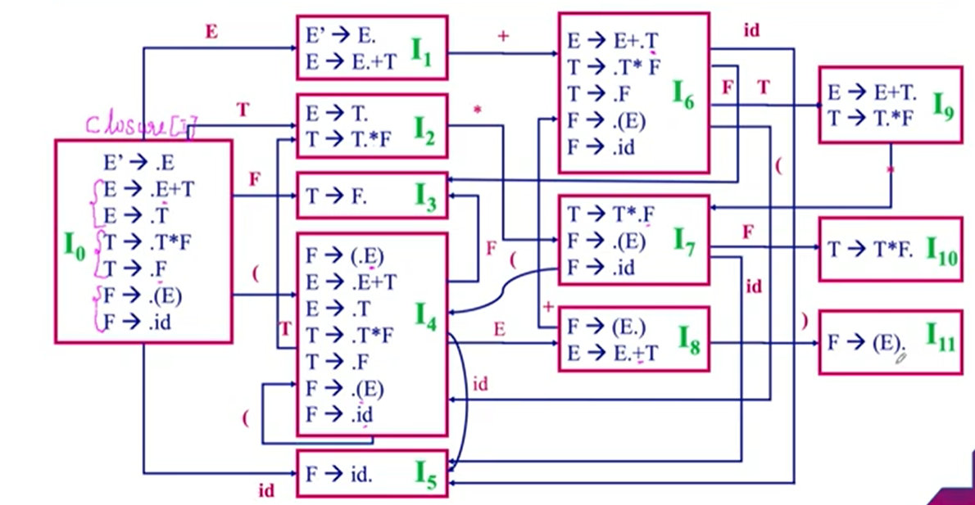
LR(0) Automation

Slide 21
Construct LR(0) Parsing Table

Slide 22
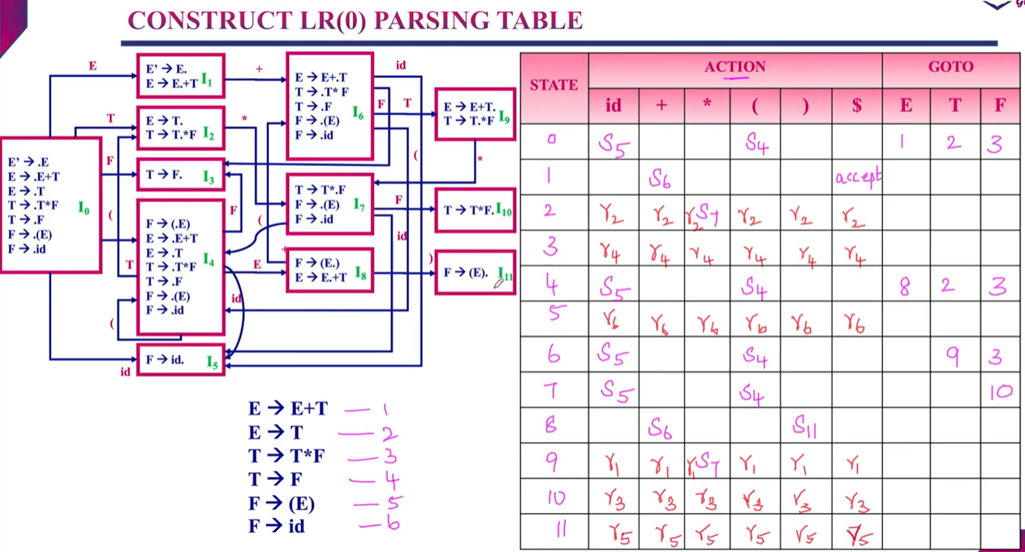

Slide 23
Construct SLR Parsing Table

Slide 24
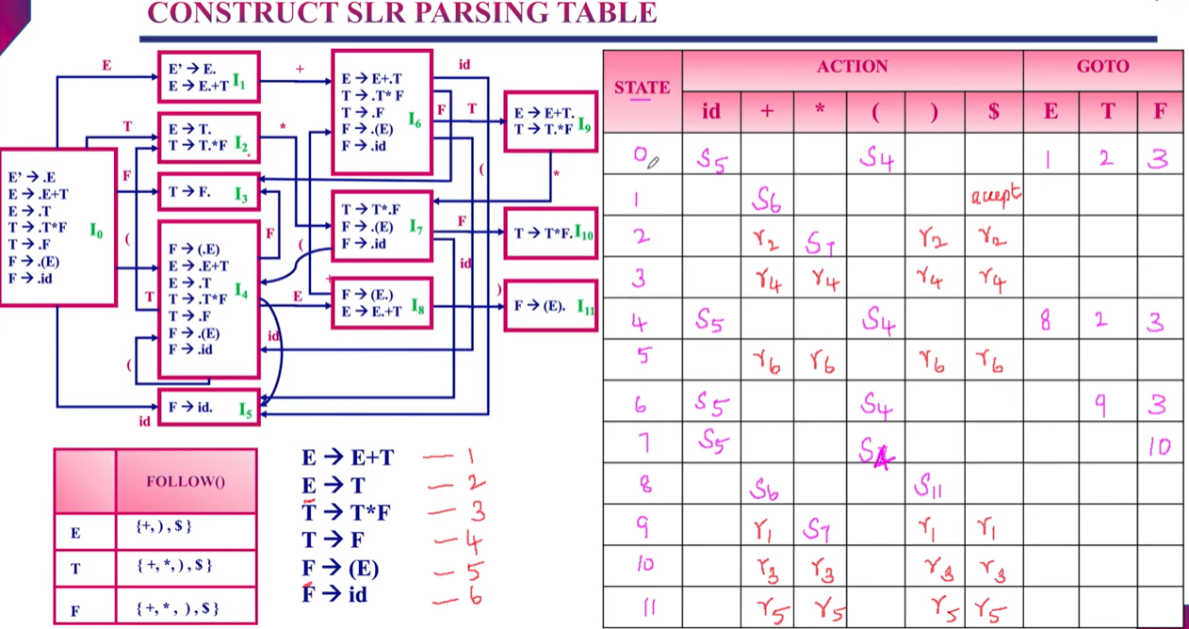

Slide 25
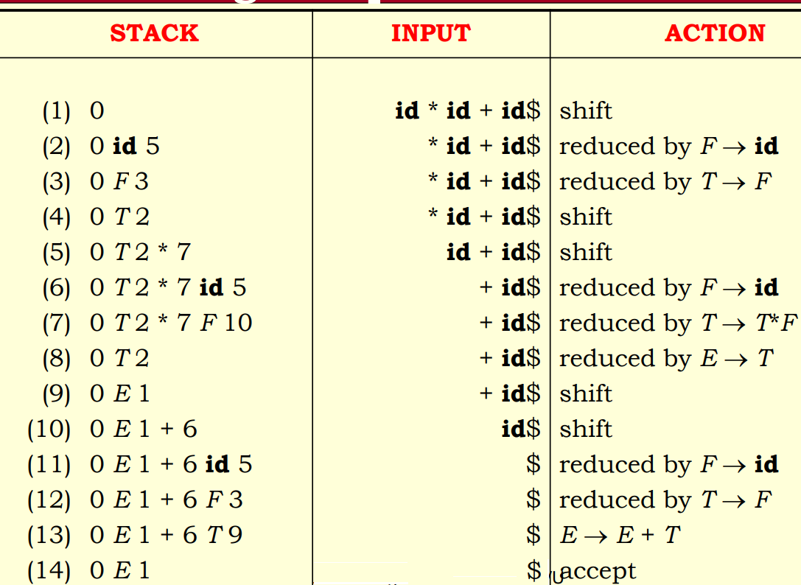
How to parse an input string using SLR Parser?

Slide 26
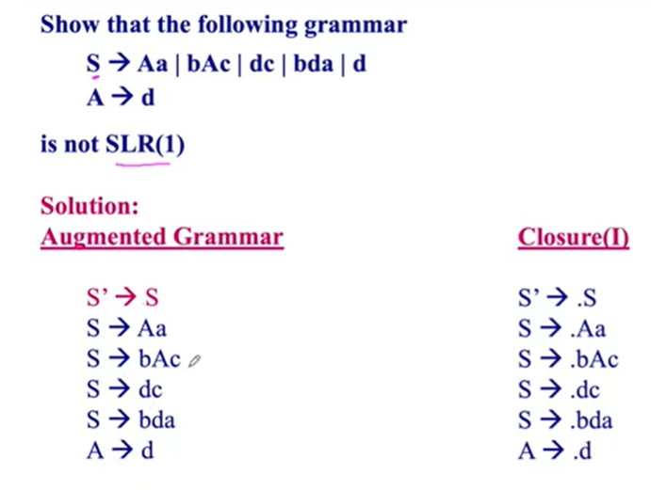

Slide 27
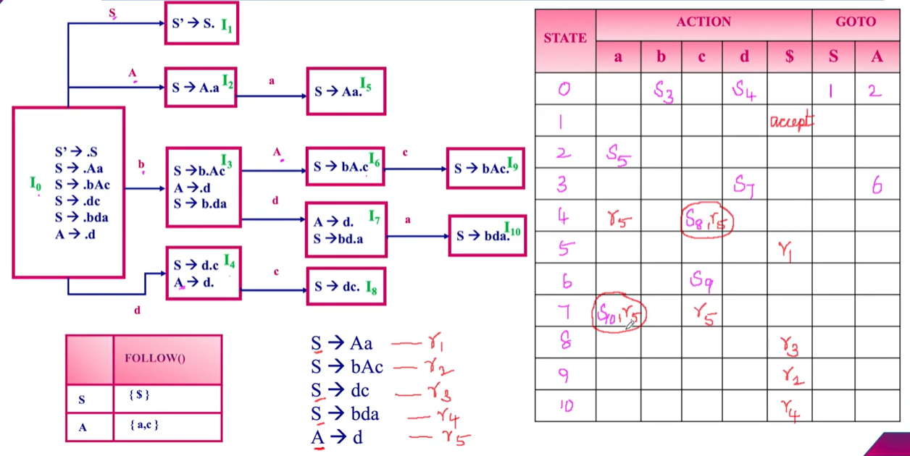

Slide 28
THANK YOU!!!

